Slide 1
Business Process Engineering
Week # 7
FALL-2025

Slide 2
Basic Purpose
A simpler business process notation when compared with BPMN notation
Helps to map ideal processes in a consistent, simple to understand and readable way without reference to any supporting document
IDEF0 is used to model business functions
As IDEF uses simple English and graphics, it allows business users and subject matter experts to work together to quickly understand, review, improve and design business
With an IDEF guideline of 3–6 boxes in each map, unnecessary detail is excluded.
When more detail is required, this is shown by creating child maps.

Slide 3
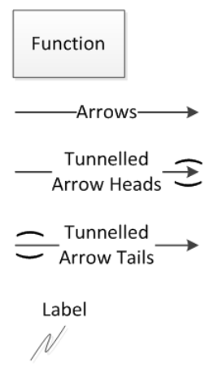
IDEF0 Symbols
Box defines functions, processes or a whole enterprise
Mapping starts with a box
Arrows show connections
Tunnelled arrows show the scope of arrows in a hierarchical model
Used to signify Inputs, Controls, Outputs and Mechanisms (ICOM)
Labels define the purpose of arrows

Slide 4
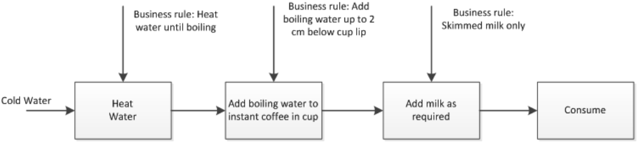
IDEF0 Functional View –
Example: Making a Cup of Coffee

Slide 5
Safely and reliably transport family of four and luggage at reasonable cost
Consider the process:
  What we want it to do?
  What resources it needs?
  What rules apply to its use?
As a driver:
  May only be interested in the fuel and tyres
As a mechanic:
  Why the engine won’t start?
  Might go down to the lowest level of decomposition

Slide 6
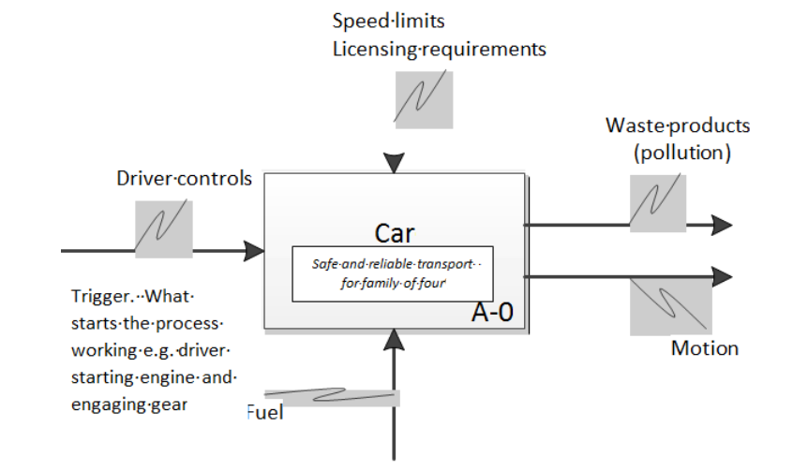
A0 – Context Map

Slide 7
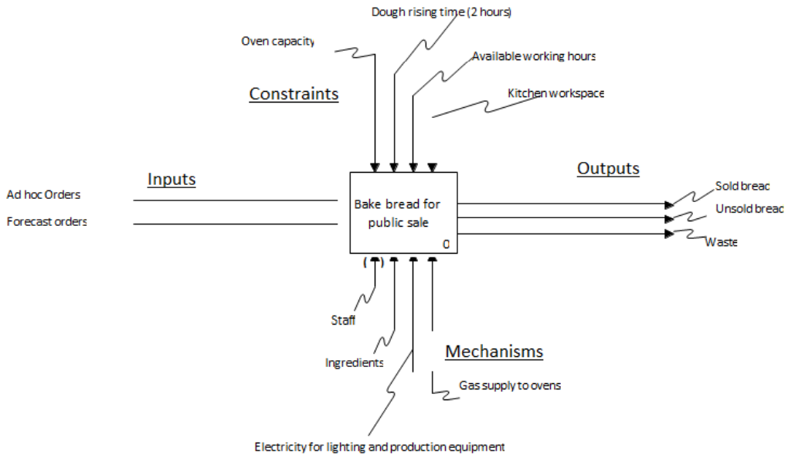
IDEF0 Model:
Bake Bread for Public Sale
Inputs, Controls, Outputs, Mechanism (ICOM)

Slide 8
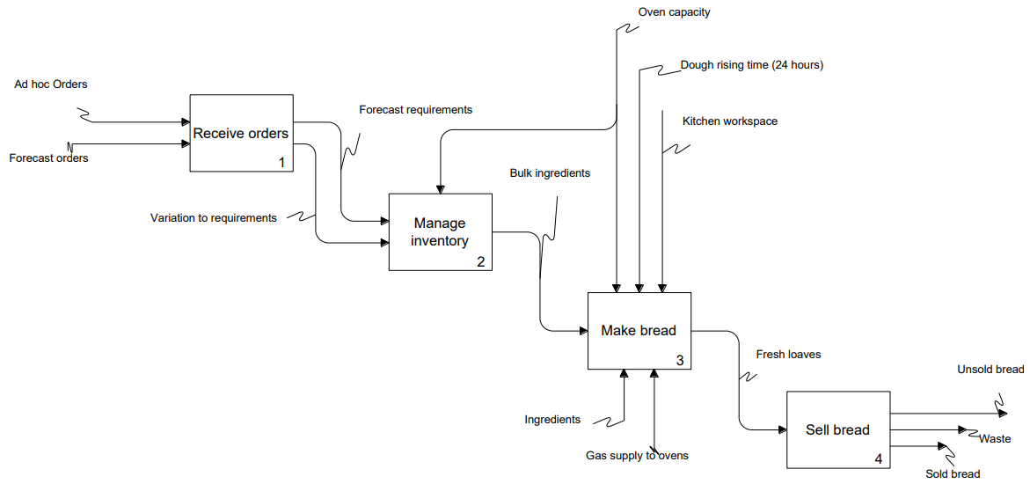
IDEF0 Example

Slide 9
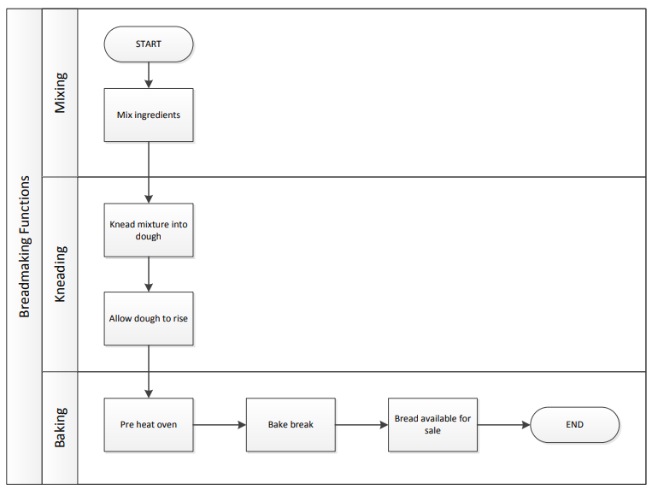
Decomposition of Step 3: Make Bread

Slide 10
Workflow Diagram
Provides a graphic overview of the business process
Uses standardized symbols and shapes to step by step show how a work is completed from start to finish
Shows who is responsible for work at what point in the process
Can help define, standardize and identify critical areas of your process
Help employees understand their roles and the order in which work is completed
Originated from manufacturing industry

Slide 11






Workflow Diagram Components
Signifies starting and ending points of the process
Denotes instructions or actions
Indicates where a decision must be made, after which the workflow proceeds in two separate paths after a “yes” or “no” decision
Points toward the next step

Slide 12
3 Usages of Workflow Diagrams
Process Analysis and Improvement
  Through visualization, a throughout understanding of how a certain business process works is obtained to find potential weaknesses or improvements.
Process Instruction
  A lot of know-how in any company is based on tribal knowledge i.e., If a key employee leaves the organization, the others can get confused on how to carry out a specific process. If the process has visual representation then the employees can check the process
Tracking & Management
  Can be used to keep track of the process in real-time i.e., who’s responsible for what ? What’s the deadline? Whether there are any hold-ups ? etc.,

Slide 13
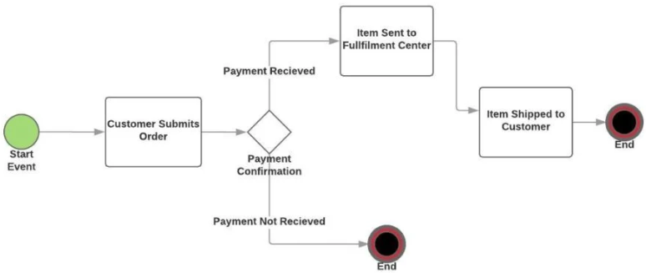
Example: Order Shipment
Customer places the order
Transaction is confirmed and money received
Item is sent to fulfilment centre for shipment
Item is shipped to the customer

Slide 14
Example: Content Marketing
Writer creates a draft of the article and sends it to the editor
Editor either approves the article and passes it to the designer or sends it back to the writer with instructions on what to fix
The editor, as per writer instructions, creates the appropriate visual assets. Sends it over to the marketer for setup
The marketer uploads the article on WordPress or CMS, optimizes it for search, shares it with influencers, etc.

Slide 15
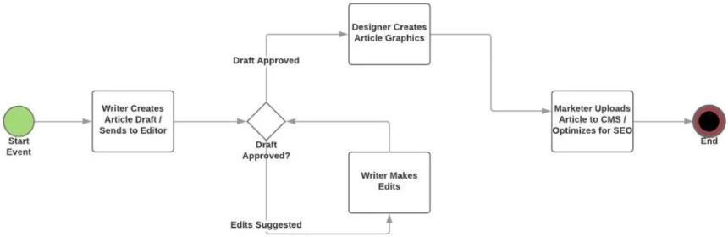
Example: Content Marketing

Slide 16
Example: Employee Onboarding
HR sends out all the paperwork to the employee
The employee sends back the filled-in documents
The HR passes them along to company management for signature and approval
Office manager ensures that the workspace and company software are both ready for the new employee
Once the new hire shows up, “employee orientation” starts

Slide 17
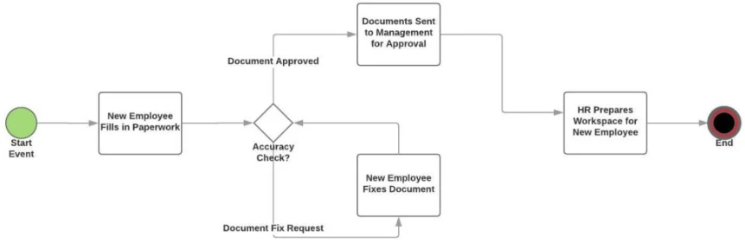
Example: Employee Onboarding

